Slide 1
Team 38
Hunter, Perry, Hongwei, Tabe, Mohammed, Adin, Dino
Advisor: Mai Zheng
Notes:
Everyone introduce themself

Slide 2
What is Orgifi?
Orgifi is a platform designed to simplify the management and discovery of clubs, enabling users to easily find, join, and manage events, memberships, and communication within organizations.
Example users include organizers of intramural sports clubs, or people who moved to a new area and are looking for hobbies
Notes:
Hunter

Slide 3
Motivation behind Orgifi
Current Problems:
Difficulty finding clubs to join.
Lack of centralized communication and event tracking.
Visions for Orgifi
Make finding and joining clubs easier.
Simplify club management for users.
Create a platform that promotes engagement and accessibility.
Notes:
Tabe

Slide 4
Motivation behind Orgifi contd.
Why it matters
Fosters stronger communities.
Saves time for organizers.
Improves users experience.
Notes:
Tabe

Slide 5
Key features
Club Discovery: Helps users find organizations or clubs based on what they are interested in.
Centralized Communication: Message and announcements within the app.
Event Management: Schedule and track club events all in one place.
Notes:
Perry

Slide 6
Who is it for?
Students: Make it easy to explore and stay engaged with campus activities.
Club leaders: Streamline recruitment, event planning, and member engagement
Broader Audience: Expandable for use by non student organizations, hobby groups, and nonprofits.
Notes:
Perry

Slide 7
User Needs
As a student and other user
Discover Clubs
Simple Joining Process
Connect with members
View event details
Notes:
Adin
As a student using Orgifi, I can easily explore clubs and request to join the ones I’m interested in, and stay connected with other members through built-in messaging.I can also keep track of upcoming events and announcements.

Slide 8
User Needs cont…
As a club leader
Public Club Page
Member & Permission Management
Group Chats
Event Creation
Notes:
Adin
Each club gets a customizable public club page to showcase who they are and what they do.Leaders can manage members and set permissions to control who can do what within the club.You can also create group chats—for example, one just for club officers to coordinate behind the scenes.And also, leaders can create and manage events, making it easy to organize meetings, or fundraisers.

Slide 9
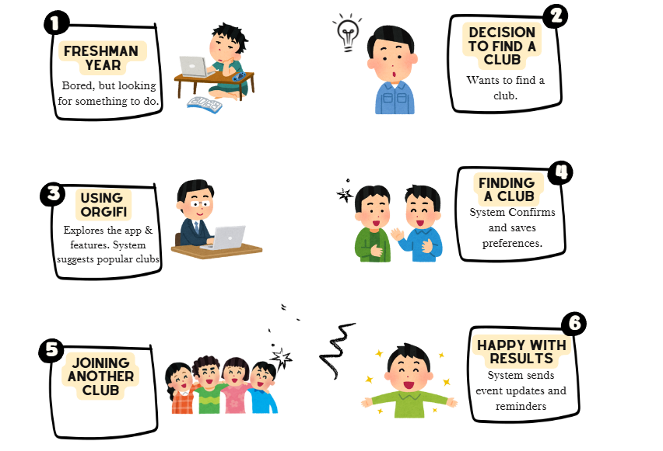
Functionality
Notes:
Adin
Here’s a quick walkthrough of what a typical user journey looks like:A student starts out just looking for something to do, they decide they want to join a club, and finds Orgifi.The app helps them discover clubs and find the ones they are interested in. They then join a club that they are interested in and they are able to stay up to date with any future events making campus life more engaging.

Slide 10
Demo

Slide 11
Technology Considerations
Front End: Next.js
Backend: Node.js
Database: MongoDB
Authentication: Firebase
Image Storage: Cloud Storage for Firebase
Additional Technologies: Turbo Repo
Notes:
Now we can take a look at the technologies powering Orgifi.
On the frontend, we use Next.js, which gives us a modern, responsive UI framework.
Our backend runs on Node.js, perfect for handling real-time data and building scalable services.
We use MongoDB as our database, giving us flexibility with structured collections for things like user data, events, and messages.
For authentication, we use Auth0, ensuring secure and seamless user login.
Media files like profile pictures or event images are handled through Firebase Cloud Storage.
And to tie everything together, we use Turborepo to manage both frontend and backend in a unified monorepo setup

Slide 12
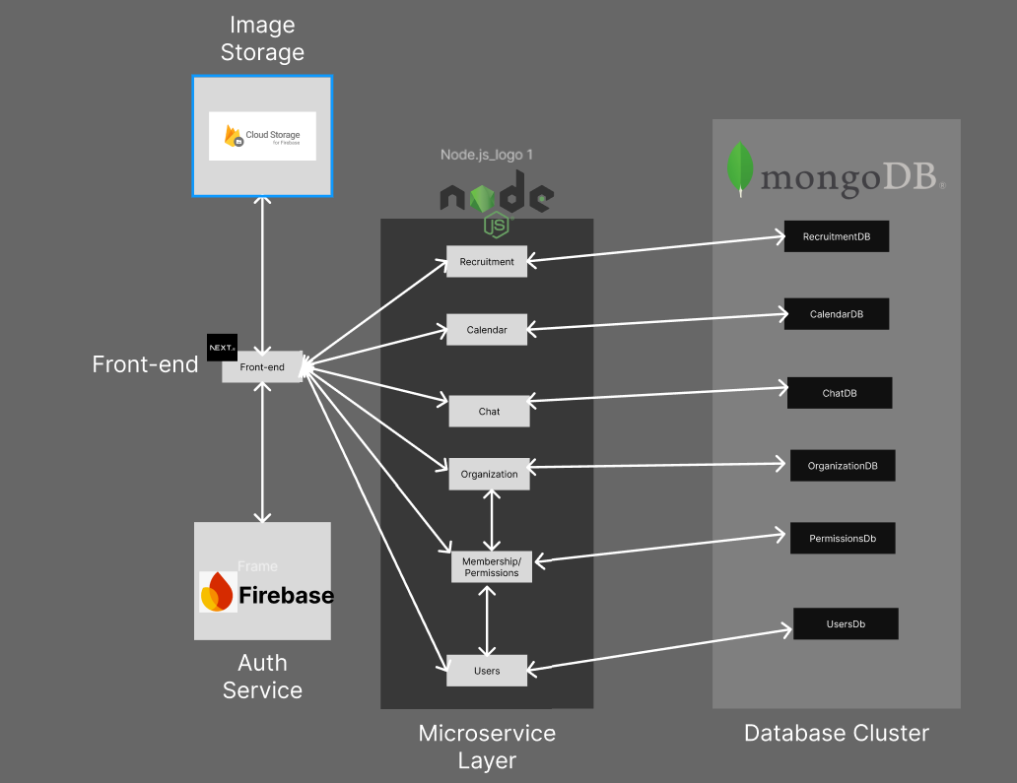
Technology Considerations
Notes:
Here’s a visual of how the system components communicate.
The frontend interacts with our backend services via API calls, sending and receiving data for things like user login, events, and chat.
Node.js runs each backend microservice, managing the business logic for features like recruitment, calendar events, and messaging.
All of this data is stored in MongoDB, with different collections for each domain — like UserDB, CalendarDB, and so on.
Firebase Cloud Storage handles image uploads, providing a reliable way to store user profile photos and media.
And finally, Auth0 handles authentication, ensuring users can securely log in and access the platform.

Slide 13
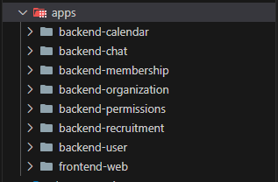
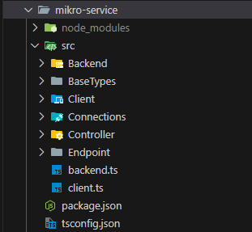
Technology Considerations - File Structure
Notes:
Orgifi is built using a monorepo structure, designed for both scalability and maintainability.
At the top level, we have an apps folder that houses all our independent microservices — including backend services like backend-user and backend-chat, as well as our frontend-web app.
Below that is the packages folder, which contains shared modules like configuration logic, common types, and backend utilities. These are reused across services to maintain consistency and reduce duplication.
On the right, you’ll see the structure of our mikro-service package, located within packages. It contains the core backend utility layer — including controllers, endpoints, and database connections — and follows an MVC-style architecture for clean separation of concerns and easier code management.

Slide 14
Testing
Jest for Unit Testing
Cypress for Integration Testing
Notes:
Hunter

Slide 15
Challenges Faced
Auth0 stopped scaling cleanly
As added more roles and custom claims, Auth0 began rejecting tokens and breaking log‑in session
WebSocket chat kept throwing build errors
Original front‑end setup bundled Socket.IO on the client but not on the server, causing compilation failures and mismatched versions.
Notes:
Hongwei Wang

Slide 16
How do we mitigated challenges
Auth0 stopped scaling cleanly
Migrated to Firebase Authentication after researching alternatives.
Firebase supported custom roles and restored reliable sign-ins without errors.
WebSocket Chat Caused Build Errors
Upgraded Next.js
Aligned Socket.IO versions
Isolated real-time code from the main bundle
Result: No crashes, successful builds.
Notes:
Hongwei Wang

Slide 17
Projects Progression
Notes:
Mohammed

Slide 18
Projects Progression - con’t
Frontend:
UX/UI Design completed.
Messaging feature.
Organization UI.
Calendar/Scheduler implemented.
Backend:
User authentication.
User database.
Organization database.
Messaging feature.
Calendar Database.
Notes:
Mohammed

Slide 19
Future Plans
Include a payment service.
Fine tuning on present features.
Implement a mobile version for easier access.

Slide 20
Conclusion
Fall 2024
Completed Orgifi Design
Created timeline plan for Spring 2025
Started creating individual Components.
Spring 2025
Completion of individual components
Connect Orgifi screens
Testing and expand
Deployment/ Infrastructure
Notes:
Mohammed

Slide 21
Questions?

